Slide 1
Verification of TCAD simulation
Student : Ying-Lun Kao
Advisor : Dr. Hao-Hsiung Lin
Date : 108. 10. 23

Slide 2
Outline
Reply from Jerry Hsieh & Message from Ivy
Lifetime measurement: Photoluminescence decay
Paper review: deep level in InP
Modeling after punch-through voltage

Slide 3
Reply from Jerry Hsieh
抗反射鍍膜材料為 Si₃N₄。
因為抗反射波長為 $1.55μm$，所以其抗反射鍍膜厚度為 $1900Å$。
因為光罩是長方形的，所以晶圓外圍有些地方無法對準擴散。
保護環
保護環
主動區
一層抗反射鍍膜($1900Å$）
兩層絕緣層($800Å×2$）
元件表面結構示意圖

Slide 4
Message from Ivy
成品已經準備好, 明天可以出貨. 下週一將收到以下
報價單 (抬頭台大嚴慶齡) x 3 張正本
發票 x 2 張 (抬頭分別 台大 及 台大嚴慶齡)
成品 : 2 pc + 1/4 pc(FREE)
Free 部份我不太確定是不是 1/4, 總之是不完整片. 敝司副總應該有跟您提過.
跟您解釋晶片狀如下
2 PCS 完整片 (有收錢, 分三個月發票) : 裸晶片, 沒有製程也沒有擴散
1/4 pc (贈送) : 裸晶片+製程+擴散
您的光罩會隨著貨一起歸還。

Slide 5
Lifetime measurement: Photoluminescence decay
Theory & interpretation of measurements (7)
Experimental data in tabular format (9)
Graphical comparison with the experimental data and TCAD simulation lifetime (3)
Detailed lifetime-related analysis & comments (5)
Discussion (2)

Slide 6
Photoluminescence decay theory of lifetime measurement
The normalized, time-dependent phenomenological PL intensity $I\left(t\right)$ is defined by
Short pulse
$$I\left(t\right)=\iiint_{V}{exp\left(−βx\right)Δn dxdydz},$$
$T=250\sim 5000$ (ns)
where $β$ is the self-absorption coefficient. In addition, charge neutrality of excess carriers and charged impurity is
$$∆n\left(t≥0\right)$$
$$∆n\left(t<0\right)$$
n-type InP
n-type InP
$$∆n±∆n_{t}=∆p,$$
($+$ for acceptor, $−$ for donor).
After $t=0$ and assuming numbers of excess holes and electrons are at all times equal, $∆n≈∆p$, “one” continuity equation is sufficient (zinc-doped p-type InP invalidates this[1]).
$$x$$
$$\frac{∂n}{∂t}=\frac{∂\left(n_{0}+Δn\right)}{∂t}=\frac{∂Δn}{∂t}=\frac{1}{q}∇∙J_{n}−R_{net}$$
Intensity
Since there is no electric field, we have only diffusion current, $J_{n}=qD_{n}∇\left(∆n\right)$, and thus
$$\frac{∂Δn}{∂t}=D_{n}∇^{2}\left(Δn\right)−R_{net}=D_{n}\frac{∂^{2}Δn}{∂x^{2}}−R_{net}.$$
Time
[1] Liu, A., & Rosenwaks, Y. (1999). Excess carriers lifetime in InP single crystals: Radiative versus nonradiative recombination. Journal of applied physics, 86(1), 430-437.

Slide 7
Photoluminescence decay theory of lifetime measurement
Since the equilibrium is disturbed, the net recombination rate generally becomes
$$R_{net}=A\left(np−n_{0}p_{0}\right)$$
$$=A\left[\left(n_{0}+∆n\right)\left(p_{0}+∆p\right)−n_{0}p_{0}\right]$$
$$∆n\left(t≥0\right)$$
$$≈An_{0}∆n≈An_{0}∆p.$$
n-type InP
If diffusivity is negligible, and $A$ is independent of excess carrier number (constant lifetime), $∆n$, $∆p$, then $\frac{d∆n}{dt}≈−An_{0}∆n$ such that
$$x$$
$$∆n=∆n\left(0\right)exp\left[−\frac{t}{{\left(An_{0}\right)}^{−1}}\right].$$
Intensity
Therefore, we define the so-called “effective” lifetime as $τ≡{\left(An_{0}\right)}^{−1}$. Hence the continuity equation becomes
$$\frac{∂Δn}{∂t}=D_{n}\frac{∂^{2}Δn}{∂x^{2}}−\frac{Δn}{τ}.$$
Time

Slide 8
Photoluminescence decay theory of lifetime measurement
$$\frac{∂Δn}{∂t}=D_{n}\frac{∂^{2}Δn}{∂x^{2}}−\frac{Δn}{τ}$$
Find $∆n$ & Plug in
$$I\left(t\right)=\int_{V}{exp\left(−βx\right)Δn dV}$$
Initial & boundary condition
We then make the usual transformation, $∆n=exp\left(−t/τ\right)u\left(x,t\right)$. The continuity equation becomes
$$∆n\left(t≥0\right)$$
$$U\left(x,s\right)≡\int_{0}^{∞}{e^{−st}u\left(x,t\right)dt}$$
n-type InP
$$D_{n}\frac{∂^{2}u}{∂x^{2}}=\frac{∂u}{∂t}$$
$$D_{n}\frac{∂^{2}U\left(x,s\right)}{∂x^{2}}=sU\left(x,s\right)−u(x,t=0)$$
Laplace transform w.r.t. $t$
$$x$$
$u(x,0)$ is the initial charge distribution as a result of the laser excitation and Beer’s law absorption.
$$U\left(x,s\right)=A exp\left(−\sqrt{\frac{sx}{D_{n}}}\right)+\frac{qαF_{0}}{s−α^{2}D_{n}}exp\left(−αx\right),$$
$$u\left(x,0\right)=∆n\left(x,t=0\right)=qαF_{0} exp\left(−αx\right)$$
Intensity
where $α$ is the absorption coefficient and $F_{0}$ is the incident photon flux in the laser pulse. If the surface recombination velocity $S>{10}^{6}$(cm/s), then $∆n\left(0,t\right)$ and thus $u\left(0,t\right)$ is approximately zero[7].
Time
$S≡\frac{J_{n,surface}}{∆n\left(0,t\right)}→∞$ as $∆n\left(0,t\right)→0$ as $u\left(0,t\right)→0$
[7] Ahrenkiel, R. K., Dunlavy, D. J., & Hanak, T. (1988). Photoluminescence lifetime in heterojunctions. Solar Cells, 24(3-4), 339-352.

Slide 9
Photoluminescence decay theory of lifetime measurement
$$U\left(0,s\right)=\int_{0}^{∞}{e^{−st}u\left(0,t\right)dt}≈0$$
$$U\left(x,s\right)=\frac{qαF_{0}}{s−α^{2}D_{n}}\left[−exp\left(−\sqrt{\frac{sx}{D_{n}}}\right)+exp\left(−αx\right)\right]$$
Find $A$
boundary condition
Using inverse Laplace transform and further calculation[7], we find $∆n$ and thus $I\left(t\right)$.
$$∆n\left(t≥0\right)$$
$$∆n\left(x,t\right)=exp\left(−\frac{t}{τ}\right)ℒ^{−1}\left\{U\left(x,s\right)\right\}$$
$$I\left(t\right)=\int_{V}{exp\left(−βx\right)Δn dV}$$
n-type InP
$$I\left(t\right)=F_{0} exp\left(−\frac{t}{τ}\right)\left[\frac{α}{α^{2}−β^{2}}e^{α^{2}Dt}erfc\left(α\sqrt{D_{n}t}\right)−\frac{β}{α^{2}−β^{2}}e^{β^{2}Dt}erfc\left(β\sqrt{D_{n}t}\right)\right]$$
$$x$$
(free recombination)
(Diffusion and self-absorption modulation)
For weak self-absorption approximation, $β≪α$, we have
Intensity
$$I\left(t\right)≈F_{0}exp\left(−\frac{t}{τ}\right)\left[\frac{e^{α^{2}D_{n}t}}{α}erfc\left(α\sqrt{D_{n}t}\right)\right]$$
Time
(Only diffusion modulation)
[7] Ahrenkiel, R. K., Dunlavy, D. J., & Hanak, T. (1988). Photoluminescence lifetime in heterojunctions. Solar Cells, 24(3-4), 339-352.

Slide 10
$$I\left(t\right)≈F_{0}exp\left(−\frac{t}{τ}\right)\left[\frac{e^{α^{2}D_{n}t}}{α}erfc\left(α\sqrt{D_{n}t}\right)\right]$$
PL data
effective lifetime $τ$
fitting
However, the effective lifetime is influenced by radiative and non-radiative mechanisms. Generally, the net recombination rate is $R_{net}=R_{r}+R_{nr}$. For example, in n-type InP, with neutrality assumption, $∆n≈∆p$, we have
$R_{r}=B\left[\left(n_{0}+∆n\right)\left(p_{0}+∆p\right)−n_{0}p_{0}\right]=B\left(n_{0}∆p+p_{0}∆n+∆n∆p\right)≈B\left(n_{0}+∆n\right)∆n$;
$$R_{nr}=\frac{\left(n_{0}+∆n\right)\left(p_{0}+∆p\right)−n_{0}p_{0}}{τ_{p0}\left(n_{0}+∆n+n_{1}\right)+τ_{n0}\left(p_{0}+∆p+p_{1}\right)}≈\frac{\left(n_{0}+∆n\right)∆n}{τ_{p0}\left(n_{0}+∆n+n_{1}\right)+τ_{n0}\left(p_{0}+∆n+p_{1}\right)}.$$
In addition, in low injection situation, $n_{0}≫p_{0}≫∆n,p_{1}, n_{1}$, we have $R_{r}≈Bn_{0}∆n$ and $R_{nr}≈\frac{n_{0}∆n}{τ_{p0}n_{0}+τ_{n0}p_{0}}$ such that
$$R_{net}≈\left(B+\frac{1}{τ_{p0}n_{0}+τ_{n0}p_{0}}\right)n_{0}∆n=An_{0}∆n$$
$$τ≡{\left(An_{0}\right)}^{−1}$$
$$τ=\frac{τ_{p0}+τ_{n0}p_{0}/n_{0}}{1+Bn_{0}\left(τ_{p0}+τ_{n0}p_{0}/n_{0}\right)}≈\frac{τ_{p0}}{1+Bn_{0}τ_{p0}}$$
Formally, when the excess carrier density is $∆n$, we define the ”lifetime” of ith recombination rate as:
$$τ_{i}≡\frac{∆n}{R_{i}}$$
$$τ_{r}=\frac{1}{B\left(n_{0}+∆n\right)},$$
$$τ_{nr}=\frac{n_{0}+∆n+n_{1}}{n_{0}+∆n}τ_{p0}+\frac{p_{0}+∆n+p_{1}}{n_{0}+∆n}τ_{n0},$$
$$τ=\frac{τ_{r}τ_{nr}}{τ_{r}+τ_{nr}}.$$

Slide 11
Formally, when the excess carrier density is $∆n$, we define the ”lifetime” of ith recombination rate as:
$$τ_{i}≡\frac{∆n}{R_{i}}$$
$$τ_{r}=\frac{1}{B\left(n_{0}+∆n\right)},$$
$$τ_{nr}=\frac{n_{0}+∆n+n_{1}}{n_{0}+∆n}τ_{p0}+\frac{p_{0}+∆n+p_{1}}{n_{0}+∆n}τ_{n0},$$
$$τ=\frac{τ_{r}τ_{nr}}{τ_{r}+τ_{nr}}.$$
$$n_{0}≫p_{0}$$ | Injection | Relative magnitude | $$τ_{r}$$ | $$τ_{nr}$$ | $τ_{r}$ vs. $τ_{nr}$ | $$τ$$ | Constant $τ$ ?
Yes | low | $$n_{0}≫p_{0}≫/≈∆n,p_{1}, n_{1}$$ | $${\left(Bn_{0}\right)}^{−1}$$ | $$τ_{p0}=τ_{minority, 0}$$ | $$τ_{r}≪τ_{nr}$$ | $${\left(Bn_{0}\right)}^{−1}$$ | Yes
 |  |  |  |  | $$τ_{r}\sim τ_{nr}$$ | $$\frac{τ_{p0}}{1+{Bn_{0}τ}_{p0}}$$ | Yes
 |  |  |  |  | $$τ_{r}≫τ_{nr}$$ | $$τ_{p0}$$ | Yes
Yes | moderate | $$∆n≈n_{0}≫p_{0}≫p_{1}, n_{1}$$ | $${\left[B\left(n_{0}+∆n\right)\right]}^{−1}$$ | $$τ_{p0}$$ | $$τ_{r}≪τ_{nr}$$ | $${\left[B\left(n_{0}+∆n\right)\right]}^{−1}$$ | No
 |  |  |  |  | $$τ_{r}\sim τ_{nr}$$ | $$\frac{τ_{p0}}{1+{B\left(n_{0}+∆n\right)τ}_{p0}}$$ | No
 |  |  |  |  | $$τ_{r}≫τ_{nr}$$ | $$τ_{p0}$$ | Yes
Yes/No | high | $$∆n≫n_{0}≫/≈p_{0}≫p_{1}, n_{1}$$ | $${\left(B∆n\right)}^{−1}$$ | $$τ_{p0}+τ_{n0}$$ | $$τ_{r}≪τ_{nr}$$ | $${\left(B∆n\right)}^{−1}$$ | No
 |  |  |  |  | $$τ_{r}\sim τ_{nr}$$ | $$\frac{τ_{p0}+τ_{n0}}{1+B∆n\left(τ_{p0}+τ_{n0}\right)}$$ | No
 |  |  |  |  | $$τ_{r}≫τ_{nr}$$ | $$τ_{p0}+τ_{n0}$$ | Yes
No | low | $$n_{0}≈p_{0}≈∆n≫p_{1}, n_{1}$$ | $${\left[B\left(n_{0}+∆n\right)\right]}^{−1}$$ | $$τ_{p0}+\frac{p_{0}+∆n}{n_{0}+∆n}τ_{n0}$$ |  | $$\frac{τ_{r}τ_{nr}}{τ_{r}+τ_{nr}}$$ | No

Slide 12
Photoluminescence decay theory of lifetime measurement
Constant
lifetime
effective lifetime $τ$
$$I\left(t\right)≈F_{0}exp\left(−\frac{t}{τ}\right)\left[\frac{e^{α^{2}Dt}}{α}erfc\left(α\sqrt{Dt}\right)\right]$$
(Minority) carrier SRH lifetime $τ_{0}$
Radiative recombination rate $B$
PL data
Least-square fitting method
Non-constant
lifetime
$$\frac{∂Δn}{∂t}=−D^{∗}\frac{∂^{2}Δn}{∂x^{2}}−\frac{Δn}{τ},$$
$$I\left(t\right)=\int_{V}{exp\left(−βx\right)Δn dV},$$
$$\frac{1}{τ}=\frac{1}{τ_{r}}+\frac{1}{τ_{nr}}$$
$$τ_{r}=\frac{1}{B\left(n_{0}+∆n\right)},$$
$$τ_{nr}=\frac{n_{0}+∆n+n_{1}}{n_{0}+∆n}τ_{p0}+\frac{p_{0}+∆n+p_{1}}{n_{0}+∆n}τ_{n0}$$
PL data
$$τ_{p0},τ_{n0},B$$
Numerical algorithm solver[1]; manually tune parameter to find the best fitting parameters
[1] Liu, A., & Rosenwaks, Y. (1999). Excess carriers lifetime in InP single crystals: Radiative versus nonradiative recombination. Journal of applied physics, 86(1), 430-437.

Slide 13
SRH lifetime of InP [experiment]
Material | Doping | Direction | SRV | B | $$δn$$ | $$τ$$ | $$τ_{r}$$ | $$τ_{nr}$$ | $$τ_{n0}$$ | $$τ_{p0}$$ | Ref.
Unit | cm⁻³ |  | cm/s | cm³s⁻¹ | cm⁻³ | ns | ns | ns | ns | ns
S [N] | $$2×{10}^{17}$$ | (100) | 100 | $$2×{10}^{−11}$$ | $$3×{10}^{14}$$ | 70* | 250* | 100±10 | 3000 | 70 | [1]
 |  |  |  |  | $$1×{10}^{15}$$ | 85* | 250* | 160±16
 |  |  |  |  | $$1×{10}^{16}$$ | 140* | 230* | 280±28
 |  |  |  |  | $$1×{10}^{17}$$ | 150* | 170* | 800±160
 |  |  |  |  | $$2×{10}^{18}$$ | 20* | 20* | 3000±2000
S [N] | $$4×{10}^{18}$$ |  |  |  | $$1×{10}^{15}$$ | 20* |  | 20±2 | ~20 | ~20
 |  |  |  |  | $$1×{10}^{18}$$ | 20* |  | 21±2
S [N] | $$3×{10}^{16}$$ |  |  |  |  | 220-480*⁽¹⁾ |  |  |  |  | [4]
S [N] | $$2×{10}^{17}$$ |  |  |  |  | 150-450*⁽¹⁾
S [N] | $$5×{10}^{18}$$ |  |  |  |  | 9-10*⁽¹⁾
* 由肉眼與直尺判斷對數圖之數據，誤差應小於 10%。 (1) 有四筆同濃度的數據，只寫出其最小最大值，差別為 InP 來源的不同(different manufacturers)。
[1] Liu, A., & Rosenwaks, Y. (1999). Excess carriers lifetime in InP single crystals: Radiative versus nonradiative recombination. Journal of applied physics, 86(1), 430-437.
[4] Landis, G. A., Jenkins, P., & Weinberg, I. (1991, April). Photoluminescence lifetime measurements in InP wafers. In [Proceedings 1991] Third International Conference Indium Phosphide and Related Materials (pp. 636-639). IEEE.
Notes:
±

Slide 14
Material | Doping | Direction | SRV | B | Light bias | $$τ$$ | $$τ_{r}$$ | $$τ_{nr}$$ | $$τ_{n0}$$ | $$τ_{p0}$$ | Ref.
Unit | cm⁻³ |  | cm/s | cm³s⁻¹ | W-cm⁻² | ns | ns | ns | ns | ns
S [N] | $$3×{10}^{16}$$ |  | $$≥{10}^{6}$$ | $$6×{10}^{−11}$$ or $$2×{10}^{−10}$$ | 250* | 175* |  |  | 230* | 210* | [2]
 |  |  |  |  | 500* | 120*
 |  |  |  |  | 750* | 85*
 |  |  |  |  | 1000* | 70*
 |  |  |  |  | 1200* | 70*
 |  |  |  |  | 1600* | 50*
S [N] | $$9×{10}^{16}$$ |  |  |  | 略 | 略 |  |  | 270* | 230*
S [N] | $$2×{10}^{17}$$ |  |  |  | 略 | 略 |  |  | 230* | 210*
Sn [N] | $$1×{10}^{18}$$ |  |  |  | 略 | 略 |  |  | 100* | 95*
S [N] | $$4×{10}^{18}$$ |  |  |  | 略 | 略 |  |  |  | 13*
S [N] | $$7×{10}^{18}$$ |  |  |  | 略 | 略 |  |  |  | 10*
* 由肉眼與直尺判斷線性圖之數據，誤差應小於 10%。
[2] Yater, J. A., Weinberg, I., Jenkins, P. P., & Landis, G. A. (1994, December). Minority-carrier lifetime in InP as a function of light bias. In Proceedings of 1994 IEEE 1st World Conference on Photovoltaic Energy Conversion-WCPEC (A Joint Conference of PVSC, PVSEC and PSEC) (Vol. 2, pp. 1709-1712). IEEE.
Notes:
±

Slide 15
Material | Doping | Direction | SRV | B | $$δn$$ | $$τ$$ | $$τ_{r}$$ | $$τ_{nr}$$ | $$τ_{n0}$$ | $$τ_{p0}$$ | Ref.
Unit | cm⁻³ |  | cm/s | cm³s⁻¹ | cm⁻³ | ns | ns | ns | ns | ns
Sn [N] | $$3×{10}^{17}$$ |  |  |  | $$3×{10}^{14}$$ | 80* | 185* | 150±15 | 7000 | 80 | [1]
 |  |  |  |  | $$1×{10}^{15}$$ | 83* | 180* | 165±16
 |  |  |  |  | $$1×{10}^{16}$$ | 110* | 160* | 300±70
 |  |  |  |  | $$1×{10}^{17}$$ | 103* | 130* | 700±300
 |  |  |  |  | $$3×{10}^{17}$$ | 80* | 80* | 3000±2000
 |  |  |  |  | $$1×{10}^{18}$$ | 38* |  | 4000±3000
Si [N] | $$5×{10}^{16}$$ | (110) | 250 |  |  | 320 |  |  |  |  | [3]
Si [N] | $$5×{10}^{16}$$ | (110) | 250 | $$3×{10}^{−11}$$ | $$3×{10}^{17}$$
 |  |  |  |  | $$4×{10}^{17}$$
 |  |  |  |  | $$1×{10}^{18}$$
 |  |  |  |  | $$3.3×{10}^{18}$$
[N] | $$4.5×{10}^{16}$$ |  | 500 |  |  | 320 |  |  |  |  | [13]
* 由肉眼與直尺判斷對數圖之數據，誤差應小於 10%。
[1] Liu, A., & Rosenwaks, Y. (1999). Excess carriers lifetime in InP single crystals: Radiative versus nonradiative recombination. Journal of applied physics, 86(1), 430-437.
[3] Rosenwaks, Y., Shapira, Y., & Huppert, D. (1992). Picosecond time-resolved luminescence studies of surface and bulk recombination processes in InP. Physical Review B, 45(16), 9108.
[13] Y. Rosenwaks, Y. Shapira, and D. Huppert, “Evidence for low intrinsic surface-recombination velocity on p-type InP,” Phys. Rev. B, vol. 44, no. 23, pp. 97–100, Dec. 1991.
Notes:
±

Slide 16
Material | Doping | Direction | SRV | B | $$δn$$ | $$τ$$ | $$τ_{r}$$ | $$τ_{nr}$$ | $$τ_{n0}$$ | $$τ_{p0}$$ | Ref.
Unit | cm⁻³ |  | cm/s | cm³s⁻¹ | cm⁻³ | ns | ns | ns | ns | ns
Undoped [N] | $$4×{10}^{15}$$ |  | $$\sim {10}^{7}$$ |  |  | 650* |  |  |  |  | [5]
S [N] | $$3×{10}^{16}$$ |  |  |  |  | 300*
S [N] | $$1×{10}^{17}$$ |  |  |  |  | 400*
S [N] | $$2×{10}^{17}$$ |  |  |  |  | 320*
Sn [N] | $$1×{10}^{18}$$ |  |  |  |  | 170*
Sn [N] | $$2×{10}^{18}$$ |  |  |  |  | 40*
S [N] | $$3×{10}^{18}$$ |  |  |  |  | 30*
S [N] | $$5×{10}^{18}$$ |  |  |  |  | 12*
S [N] | $$7×{10}^{18}$$ |  |  |  |  | 6*
OMVPE Undoped [N] | $$3×{10}^{15}$$ |  | 5000 |  |  | 20 | $$>500$$ |  |  |  | [12]
 |  |  | 5000 |  |  | 40 | $$>500$$
 |  |  | 3000 |  |  | 30 | $$>500$$
* 由肉眼與直尺判斷對數圖之數據，誤差應小於 10%。
[5] Jenkins, P., Landis, G. A., Weinberg, I., & Kneisel, K. (1991, October). Minority carrier lifetime in indium phosphide. In The Conference Record of the Twenty-Second IEEE Photovoltaic Specialists Conference-1991 (pp. 177-181). IEEE.
[12] S. Bothra, S. Tyagi, S. K. Ghandhi, and J. M. Borrego, “Surface recombination velocity and lifetime in InP,” Solid State Electronics, vol. 34, no. 1, pp. 47–50, 1991.

Slide 17
Material | Doping | Direction | SRV | B | $$δn$$ | $$τ$$ | $$τ_{r}$$ | $$τ_{nr}$$ | $$τ_{n0}$$ | $$τ_{p0}$$ | Ref.
Unit | cm⁻³ |  | cm/s | cm³s⁻¹ | cm⁻³ | ns | ns | ns | ns | ns
LPE [N] | $$3×{10}^{15}$$ |  |  |  |  | 20 - 40⁽¹⁾ |  |  |  |  | [6]
LPE [N] | $$1×{10}^{16}$$ |  |  |  |  | 5.7 - 8.6⁽²⁾
Wafer [N] | $$1×{10}^{16}$$ |  |  |  |  | 3000⁽³⁾
LPE [N] | $$1.5×{10}^{16}$$ |  |  |  |  | 1.4 - 4.3
Wafer [N] | $$1.5×{10}^{16}$$ |  |  |  |  | 200
Wafer [N] | $$5×{10}^{16}$$ |  |  |  |  | 320
Wafer [N] | $$1×{10}^{17}$$ |  |  |  |  | 425⁽³⁾
Wafer [N] | $$2×{10}^{18}$$ |  |  |  |  | 100
Undoped |  | (100) | 100 | 0.1 | $$<1×{10}^{15}$$ |  | ~1000 |  |  |  | [1]
 |  |  |  |  | $$1×{10}^{15}$$ |  |  | >1000
 |  |  |  |  | $$1×{10}^{17}$$
 |  |  |  |  | $$1×{10}^{18}$$
(1) Photoconductivity decay (1) Differential Capacitance (3) Junction recovery
[1] Liu, A., & Rosenwaks, Y. (1999). Excess carriers lifetime in InP single crystals: Radiative versus nonradiative recombination. Journal of applied physics, 86(1), 430-437.
[6] INSPEC (1991). Properties of indium phosphide (No. 6).

Slide 18
Material | Doping | Direction | SRV | B | $$δn$$ | $$τ$$ | $$τ_{r}$$ | $$τ_{nr}$$ | $$τ_{n0}$$ | $$τ_{p0}$$ | Ref.
Unit | cm⁻³ |  | cm/s | cm³s⁻¹ | cm⁻³ | ns | ns | ns | ns | ns
Zn [P] | $$1.8×{10}^{16}$$ |  | $$≥{10}^{6}$$ |  | 略 | 略 |  |  | 10* | 50* | [2]
Zn [P] | $$2.6×{10}^{16}$$ |  |  |  | 略 | 略 |  |  | 9* | 40*
Zn [P] | $$4×{10}^{17}$$ |  |  |  | 略 | 略 |  |  | 1* | 6*
Cd [P] | $$9×{10}^{17}$$ |  |  |  | 略 | 略 |  |  | 0.5*⁽¹⁾
Zn [P] | $$4×{10}^{18}$$ |  |  |  | 略 | 略 |  |  | 0.5*⁽¹⁾
Zn [P] | $$4×{10}^{15}$$ | (110) | 500 |  |  | 33 |  |  |  |  | [3]
Zn [P] | $$5×{10}^{16}$$ | (110) | 500 |  |  | 4
Zn [P] | $$5×{10}^{17}$$ | (100) | 500 |  |  | 0.85
Wafer [P] | $$5×{10}^{16}$$ |  |  |  |  | 200-300 |  |  |  |  | [6]
* 由肉眼與直尺判斷對數圖之數據，誤差應小於 10%。 (1) The measured lifetimes are constantly below 0.5ns, which is the limit of the system resolution.
[2] Yater, J. A., Weinberg, I., Jenkins, P. P., & Landis, G. A. (1994, December). Minority-carrier lifetime in InP as a function of light bias. In Proceedings of 1994 IEEE 1st World Conference on Photovoltaic Energy Conversion-WCPEC (A Joint Conference of PVSC, PVSEC and PSEC) (Vol. 2, pp. 1709-1712). IEEE.
[3] Rosenwaks, Y., Shapira, Y., & Huppert, D. (1992). Picosecond time-resolved luminescence studies of surface and bulk recombination processes in InP. Physical Review B, 45(16), 9108.
[4] Landis, G. A., Jenkins, P., & Weinberg, I. (1991, April). Photoluminescence lifetime measurements in InP wafers. In [Proceedings 1991] Third International Conference Indium Phosphide and Related Materials (pp. 636-639). IEEE.
[6] INSPEC (1991). Properties of indium phosphide (No. 6).

Slide 19
Material | Doping | Direction | SRV | B | $$δn$$ | $$τ$$ | $$τ_{r}$$ | $$τ_{nr}$$ | $$τ_{n0}$$ | $$τ_{p0}$$ | Ref.
Unit | cm⁻³ |  | cm/s | cm³s⁻¹ | cm⁻³ | ns | ns | ns | ns | ns
Zn [P] | $$1.8×{10}^{16}$$ |  |  |  |  | 8.1-41*⁽¹⁾ |  |  |  |  | [4]
Zn [P] | $$1.5×{10}^{17}$$ |  |  |  |  | 1.5-2.4*⁽¹⁾
Zn [P] | $$1×{10}^{16}$$ |  | $$\sim {10}^{7}$$ |  |  | 230* |  |  |  |  | [5]
Zn [P] | $$1.7×{10}^{16}$$ |  |  |  |  | 40*
Zn [P] | $$3×{10}^{16}$$ |  |  |  |  | 15*
Zn [P] | $$2×{10}^{17}$$ |  |  |  |  | 1.4*
Cd [P] | $$4×{10}^{17}$$ |  |  |  |  | 1.1*
[P] | $$1×{10}^{16}$$ |  |  |  | $$E_{p}=1.302\left(eV\right)$$ | 157 |  |  |  |  | [7]
[P] | $$1×{10}^{16}$$ |  |  |  | $$E_{p}=1.323\left(eV\right)$$ | 210
* 由肉眼與直尺判斷對數圖之數據，誤差應小於 10%。 (1) 依序有五、四筆同濃度的數據，只寫出其最小最大值，差別在 InP 成長方式的不同。
[4] Landis, G. A., Jenkins, P., & Weinberg, I. (1991, April). Photoluminescence lifetime measurements in InP wafers. In [Proceedings 1991] Third International Conference Indium Phosphide and Related Materials (pp. 636-639). IEEE.
[5] Jenkins, P., Landis, G. A., Weinberg, I., & Kneisel, K. (1991, October). Minority carrier lifetime in indium phosphide. In The Conference Record of the Twenty-Second IEEE Photovoltaic Specialists Conference-1991 (pp. 177-181). IEEE.
[7] Ahrenkiel, R. K., Dunlavy, D. J., & Hanak, T. (1988). Photoluminescence lifetime in heterojunctions. Solar Cells, 24(3-4), 339-352.

Slide 20
Material | Doping | Direction | SRV | B | $$δn$$ | $$τ$$ | $$τ_{r}$$ | $$τ_{nr}$$ | $$τ_{n0}$$ | $$τ_{p0}$$ | Ref.
Unit | cm⁻³ |  | cm/s | cm³s⁻¹ | cm⁻³ | ns | ns | ns | ns | ns
Zn [P] | $$4×{10}^{16}$$ | (100) |  |  | $$1×{10}^{14}$$ |  |  |  | 0.5 | 100 | [1]
 |  |  |  |  | $$1×{10}^{16}$$
Zn [P] | $$4×{10}^{16}$$ |  |  |  |  | 0.75 |  |  |  |  | [12]
 |  |  |  |  |  | 1.5
Zn [P] | $$6×{10}^{15}$$ |  | 500 |  |  | 23 |  |  |  |  | [13]
Zn [P] | $$4.5×{10}^{16}$$ |  | 500 |  |  | 4
Zn [P] | $$4.5×{10}^{17}$$ |  | 500 |  |  | 0.85
[1] Liu, A., & Rosenwaks, Y. (1999). Excess carriers lifetime in InP single crystals: Radiative versus nonradiative recombination. Journal of applied physics, 86(1), 430-437.
[12] S. Bothra, S. Tyagi, S. K. Ghandhi, and J. M. Borrego, “Surface recombination velocity and lifetime in InP,” Solid State Electronics, vol. 34, no. 1, pp. 47–50, 1991.
[13] Y. Rosenwaks, Y. Shapira, and D. Huppert, “Evidence for low intrinsic surface-recombination velocity on p-type InP,” Phys. Rev. B, vol. 44, no. 23, pp. 97–100, Dec. 1991.

Slide 21
SRH lifetime of InP [Simulation]
Material | Doping | Direction | SRV | B | $$δn$$ | $$τ$$ | $$τ_{r}$$ | $$τ_{nr}$$ | $$τ_{n0}$$ | $$τ_{p0}$$ | Ref.
Unit | cm⁻³ |  | cm/s | cm³s⁻¹ | cm⁻³ | ns | ns | ns | ns | ns
 |  |  |  |  |  |  |  |  | 1 | 1 | [8]
 |  |  |  |  |  |  |  |  | 1 | 1 | [9]
 |  |  |  |  |  |  |  |  | 1 | 1 | [10]
[8] Xu, J., Chen, X., Wang, W., & Lu, W. (2016). Extracting dark current components and characteristics parameters for InGaAs/InP avalanche photodiodes. Infrared Physics & Technology, 76, 468-473.
[9] Wang, X. D., Hu, W. D., Chen, X. S., Lu, W., Tang, H. J., Li, T., & Gong, H. M. (2008). Dark current simulation of InP/In 0.53 Ga 0.47 As/InP pin photodiode. Optical and quantum electronics, 40(14-15), 1261-1266.
[10] Parks, J. W., Smith, A. W., Brennan, K. F., & Tarof, L. E. (1996). Theoretical study of device sensitivity and gain saturation of separate absorption, grading, charge, and multiplication InP/InGaAs avalanche photodiodes. IEEE transactions on electron devices, 43(12), 2113-2121.

Slide 22
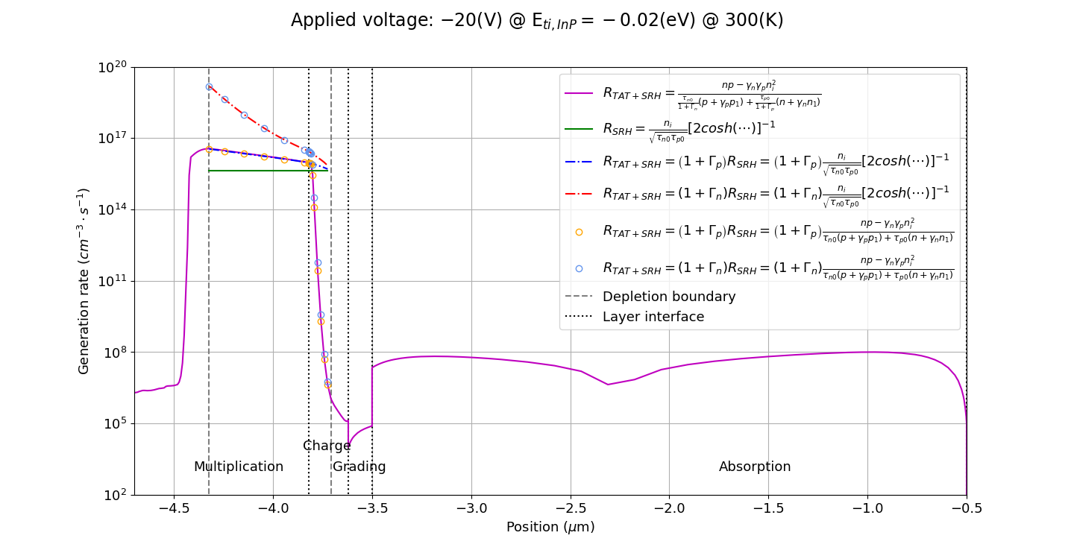
為了討論 lifetime 與摻雜濃度的關係，我們需要藉由載子再生速率找到擊穿前之最大空乏區寬度，再藉此尋找對 SRH 有影響之 p-type InP 濃度範圍。
$$x=−4.417$$

Slide 23
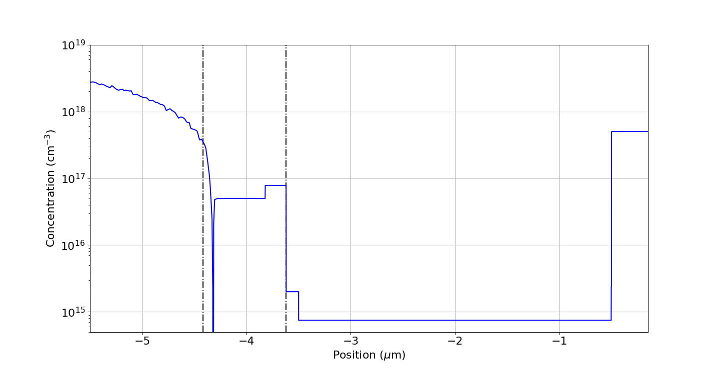
擊穿前之空乏區約略範圍
$$V_{applied}=−20\left(V\right)$$
3.36e17
$$x=−4.417$$

Slide 24
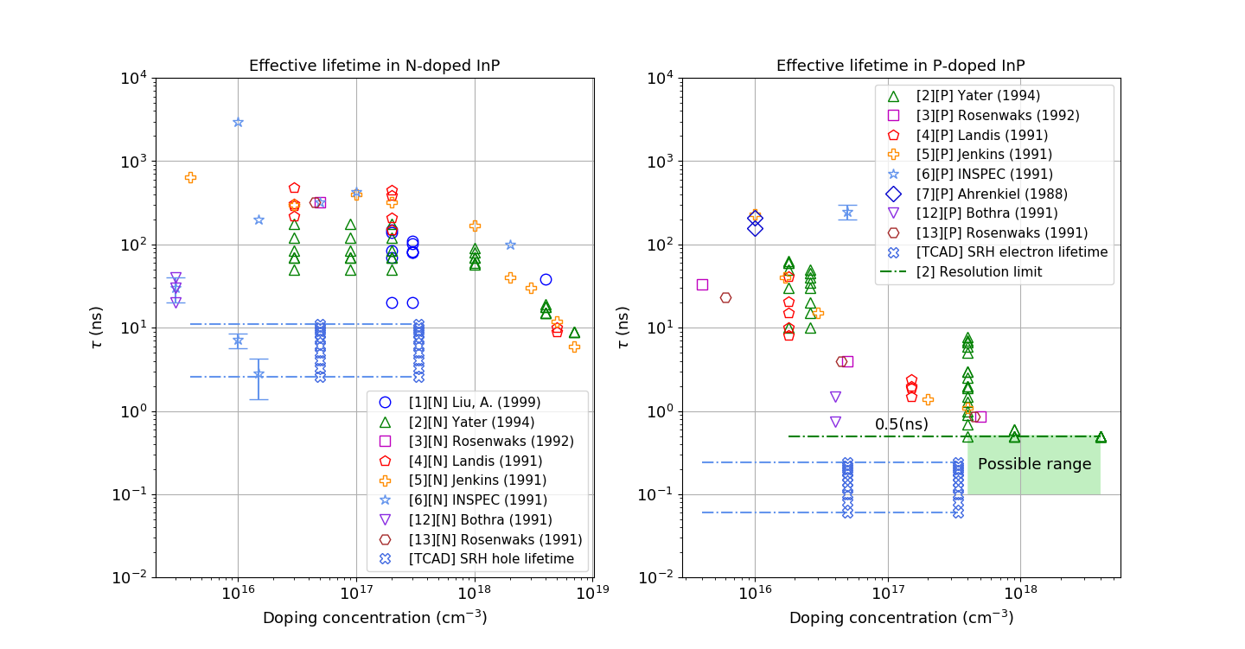
240K
[P]
330K
[N]
330K
240K
[N]
[P]

Slide 25
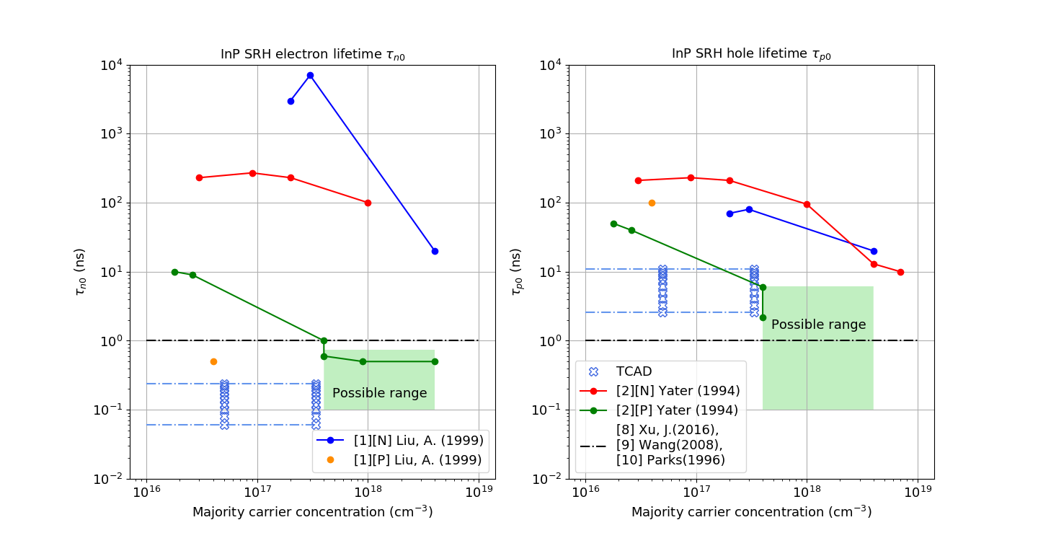
330K
[P]
240K
[N]
240K
[P]
330K
[N]

Slide 26
Related Information of SRH lifetime of InP
Ref. | Material condition | Analysis and comments
[1] | The InP samples were liquid encapsulated Czochralski (LEC) grown (100) wafers. The samples were etched by aqua-regia and rinsed by de-ionized water before the measurements. | High concentration of SRH recombination centers could cause very short effective lifetime. The great difference in minority carrier lifetimes between n- and p-type InP has been reported in the past. In addition, we have found that the minority carrier lifetime in n-type direct band gap semiconductors in always greater than that in p-type semiconductors doped to the same level. A very basic and important question is whether this is an intrinsic difference between the physical properties of n- and p-type semiconductors. On the other hand, it might be caused by p-type dopants that induce deeper recombination centers than those induced by n-type dopants in n-type samples. These hypotheses and a few others are currently under study.
[1] Liu, A., & Rosenwaks, Y. (1999). Excess carriers lifetime in InP single crystals: Radiative versus nonradiative recombination. Journal of applied physics, 86(1), 430-437.

Slide 27
Related Information of SRH lifetime of InP
Ref. | Material condition | Analysis and comments
[2] | Both InP wafers were grown by Nippon Mining using liquid-encapsulated Czochralski growth. No special surface preparation was done to the wafers. | Measured efficiencies of InP n/p solar cells are significantly lower than expected from theoretical models, suggesting that the materials properties deteriorate during processing.
[3] | The samples used were n- and p-type InP with either (110) or (100) surface orientation, supplied by MCP Electronic Materials. The samples were etched by aqua-regia, and atomically clean and visually flat (110) surfaces were achieved by cleavage of bars in an UHV chamber at pressures below $1×{10}^{−11}$ Torr. | It has been shown that the lifetime measured on n-type crystals are in the range of 1-3000 ns, depending on crystal quality and growth methods. Recombination cross-section is much smaller for shallower traps. Deeper traps have a much higher cross-section for electron-hole recombination, thus decreasing $τ_{p0}$ and $τ_{n0}$.
[2] Yater, J. A., Weinberg, I., Jenkins, P. P., & Landis, G. A. (1994, December). Minority-carrier lifetime in InP as a function of light bias. In Proceedings of 1994 IEEE 1st World Conference on Photovoltaic Energy Conversion-WCPEC (A Joint Conference of PVSC, PVSEC and PSEC) (Vol. 2, pp. 1709-1712). IEEE.
[3] Rosenwaks, Y., Shapira, Y., & Huppert, D. (1992). Picosecond time-resolved luminescence studies of surface and bulk recombination processes in InP. Physical Review B, 45(16), 9108.

Slide 28
Related Information of SRH lifetime of InP
Ref. | Material condition | Analysis and comments
[4] | The experimental set-up described has been used to measure the photoluminescence lifetime in n- and p-type InP wafers of various doping levels from various manufacturers. | The spread in the lifetime measured for material of the same doping concentration shows significant differences in lifetime achieved in wafers grown by different methods, surface treatments and purchased from different manufacturers. The results also show the marked difference in the lifetime of n-type and p-type InP of the same doping levels.
[11] | The InP sample used in this study were undoped, n-type single crystals grown by the LEC method. Carrier densities of the samples were $5×{10}^{15}\sim 1×{10}^{17}$ (cm⁻³) and dislocation densities were $0\sim 4×{10}^{5}$ (cm⁻²). | Minority-carrier lifetime in InP single crystals can be explained by a simple model in which dislocations and donor impurities act as recombination centers.
[4] Landis, G. A., Jenkins, P., & Weinberg, I. (1991, April). Photoluminescence lifetime measurements in InP wafers. In [Proceedings 1991] Third International Conference Indium Phosphide and Related Materials (pp. 636-639). IEEE.
[11] M. Yamaguchi, S. Shinoyama, and C. Uemura, “Electron mobility and minority‐carrier lifetime of n‐InP single crystals grown by liquid‐encapsulated Czochralski method,” Journal of Applied Physics, vol. 52, no. 10, pp. 6429–6431, Oct. 1981.

Slide 29
Related Information of SRH lifetime of InP
Ref. | Material condition | Analysis and comments
[5] | Our measurement were made on InP wafers used as-received, sometimes after a chemical thinning step, but with no additional processing. As-received InP wafers have a thickness of ~350 μm. In order to increase the signal-to-noise ratio, most samples were chemically thinned using HCl to ~40 μm – 100 μm. N-type samples were liquid-encapsulated Czochralski (LEC) grown wafers. | The handful of studies that have been done show a wide range of values and indicate that material quality and device processing have a substantial effect on minority carrier properties. Modeling of high efficiency n⁺/p solar cells, indicate a hole lifetime of ~0.1 ns in the n⁺ emitter, much lower than the values expected from our data. On unprocessed material, Etcheberry et al. results imply a hole lifetime of 20 ns. The reports on p-type InP are equally varied. A report of 1.6 ns electron lifetime in the $5×{10}^{16}$ zinc doped base of an InP diode (in low injection) further illustrates the disparity found in the literature. It is clear that the material properties of InP vary considerably with growth technique and processing.
[5] Jenkins, P., Landis, G. A., Weinberg, I., & Kneisel, K. (1991, October). Minority carrier lifetime in indium phosphide. In The Conference Record of the Twenty-Second IEEE Photovoltaic Specialists Conference-1991 (pp. 177-181). IEEE.

Slide 30
Related Information of SRH lifetime of InP
Ref. | Material condition | Analysis and comments
[6] | Data exist for both single crystal wafers and epitaxial material. | The data on minority-carrier lifetime in both n and p-type InP are rather limited and inconsistent. Scatter in the data is very severe.
[7] | Indium-tin-oxide(ITO)/InP is prepared by ion-beam and r.f. sputtering of indium tin oxide onto p-type InP substrates. | The degradation of lifetime after ITO deposition is apparent here. It has dropped from 300 ns to 30 ns. This change must be caused by compositional changes. Previous work has suggested that ITO deposition on InP results the incorporation of defects near the interface. Previous data on lifetime in InP have been sparse and inconsistent.
[6] INSPEC (1991). Properties of indium phosphide (No. 6).
[7] Ahrenkiel, R. K., Dunlavy, D. J., & Hanak, T. (1988). Photoluminescence lifetime in heterojunctions. Solar Cells, 24(3-4), 339-352.

Slide 31
Discussion
實驗數據可靠度
就目前了解，大多研究是在 $S>{10}^{6}$(cm/s)假設下，使用最小平方法擬合實驗數據以求得 effective lifetime [2][4][5][7]，因此 SRV 對 lifetime 研究影響顯著，並且其 lifetime 仍須就 injection、doping、trap level等參數相對大小來加以分析詮釋。目前看到藉此法得來的 SRH lifetime 僅有 Yater(1994)[2][4]，其餘則停留在仍須進一步分析詮釋的 effective lifetime 階段。根據 Nolte 分析[14]，SRV 主要受材料表面 dangling-bond energy 影響，因此僅有內部摻質差別的 n- 與 p-type InP 的 SRV 應該相同。然而 n-type InP 的 SRV 則卻須小於 1000 (cm/s) [16]，與 ${10}^{6}$(cm/s) 假設差距甚大。不過倘若 Yater(1994) 之 p-type InP 表面覆有如 Au 與 Ag 的 unreactive metals，那麼其 SRV 則可能高達 $3×{10}^{6}$(cm/s)[13]。也有其他研究指出 p-type InP SRV 高達 $2×{10}^{4}$與 $1.5×{10}^{5}$(cm/s)[15]。根據 Y. Rosenwaks 分析[13]，p-type InP 之 SRV 則應該約 500 (cm/s)。由於 SRV 仍富有爭議，所以我認為各實驗數據皆仍有其參考價值。
為何 TCAD SRH lifetime 比實驗數據還要小約 10 倍呢？
其一，用以測量 lifetime 的 InP 樣品幾乎沒有經過其他熱處理，而我們的 InP 倍增層有另外經過兩道可能會降低 lifetime 的熱擴散[2]。其二，熱擴散也使得漸變層 InGaAsP 中的 As、Ga 向上擴散至 InP 倍增層，而引進其他元素而對組成比例造成的改變也可能會降低 lifetime[7]。最後，我們與文獻中的樣品成長方式與環境也不盡相同，相信也會影響 trap 濃度 $N_{t}$，進而改變 lifetime。

Slide 32
Discussion
為何在 $300K$ 時，$τ_{p0} 比 τ_{n0}$ 高出大約 70 倍呢？
由於 $τ_{p0}≡{\left(σ_{p}v_{p}N_{t}\right)}^{−1}、τ_{n0}≡{\left(σ_{n}v_{n}N_{t}\right)}^{−1}$且假設 $v_{p}≈1.7×{10}^{5} (m/s)$、 $v_{n}≈3.9×{10}^{5} (m/s)$，所以 $σ_{n}/σ_{p}≈30.5$。此外，因為 Coulombic-attractive trap 有著比較大的 capture cross-section，所以這表示我們的 trap 應該是帶負電以吸引電洞、排斥電子的 hole trap，與 TCAD 模擬之 $E_{ti}=−0.02\left(eV\right)<0$一致。又因為 donor-like trap 在有電子時不帶電，釋放電子後帶正電； acceptor-like trap 則是在有電子時帶負電，釋放電子後帶不帶電，所以我推測 InP 可能有著 acceptor-like trap (hole trap)。不過因為我們對 SRH recombination 機制做了 Single level 的假設，實際狀況應非如此，所以仍需進一步研究確認。
Notes:
為何在 $300K$ 時，$τ_{p0} 比 τ_{n0}$ 高出大約 70 倍呢？
由於 $τ_{p0}≡{\left(σ_{p}v_{p}N_{t}\right)}^{−1}、τ_{n0}≡{\left(σ_{n}v_{n}N_{t}\right)}^{−1}$且假設 $v_{p}≈1.7×{10}^{5} (m/s)$、 $v_{n}≈3.9×{10}^{5} (m/s)$，所以 $σ_{n}/σ_{p}≈30.5$。此外，因為 Coulombic-attractive trap 有著比較大的 capture cross-section，所以這表示我們的 trap 應該是帶負電以吸引電洞、排斥電子的 hole trap，與 TCAD 模擬之 $E_{ti}=−0.02\left(eV\right)<0$一致。又因為 donor-like trap 在有電子時不帶電，釋放電子後帶正電； acceptor-like trap 則是在有電子時帶負電，釋放電子後帶不帶電，所以我推測 InP 可能有著 acceptor-like trap (hole trap)。不過因為我們對 SRH recombination 機制做了 Single level 的假設，實際狀況應非如此，所以仍需進一步研究確認。

Slide 33
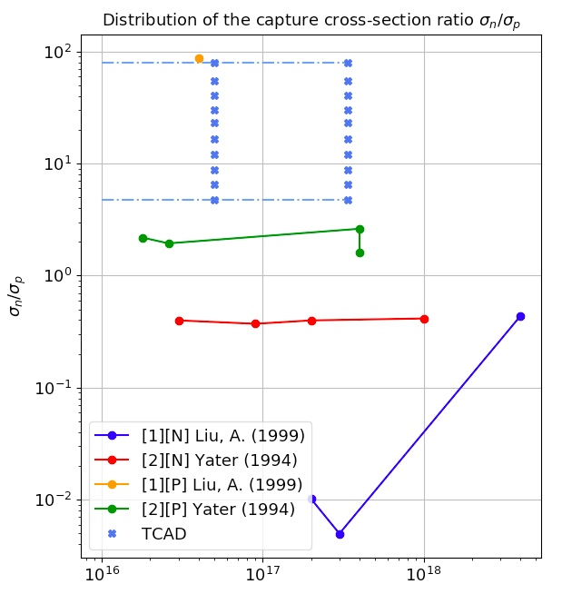
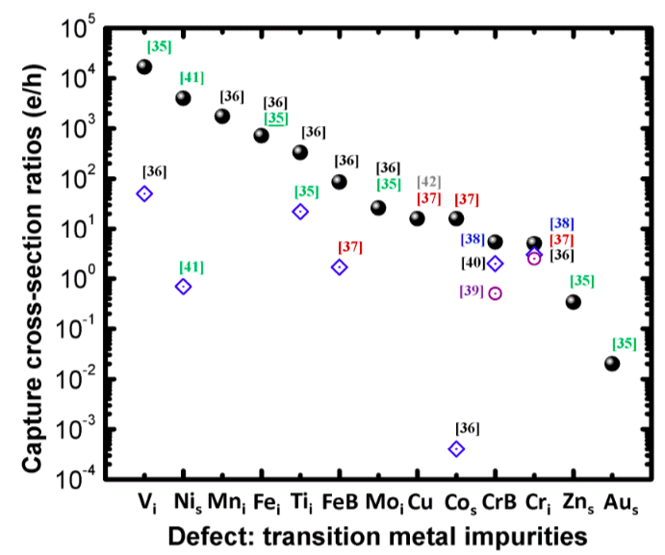
330K
InP
300K
240K
Si
[15] A. B, K. MM, H. MI, D. OE, A. AA, A. F, and T. N, “Emerging frontiers of N-Type silicon material for photovoltaic applications: The impurity-defect interactions,” Front Nanosci Nanotech, vol. 1, no. 1, pp. 2–12, 2015.

Slide 34
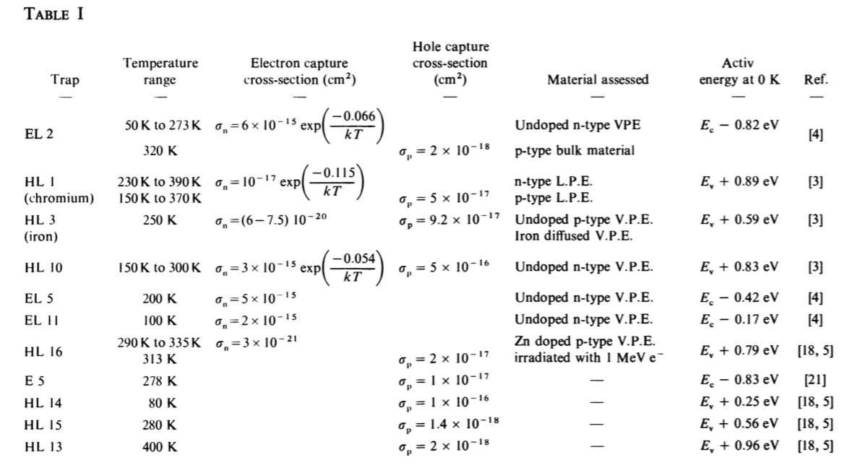
GaAs
$$σ_{n}/σ_{p}=8×{10}^{−4}$$
[16] A. Mitonneau, A. Mircea, G. M. Martin, and D. Pons, “Electron and hole capture cross-sections at deep centers in gallium arsenide,” Rev. Phys. Appl. (Paris), vol. 14, no. 10, pp. 853–861, 1979.
$$σ_{n} (300K)/σ_{p}=0.75$$

Slide 35
Paper review: deep level in InP
[17] S. R. McAfee, F. Capasso, D. V. Lang, A. Hutchinson, and W. A. Bonner, “A study of deep level in bulk n‐InP by transient spectroscopy,” Journal of Applied Physics, vol. 52, no. 10, pp. 6158–6164, Oct. 1981.
[18] M. Levinson, H. Temkin, and W. A. Bonner, “Electron bombardment induced defect states in p-InP,” Journal of Electronic Materials, vol. 12, no. 2, pp. 423–432, 1983.

Slide 36
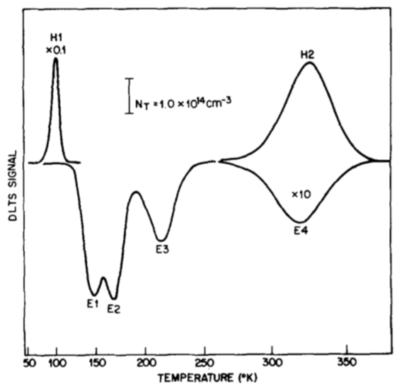
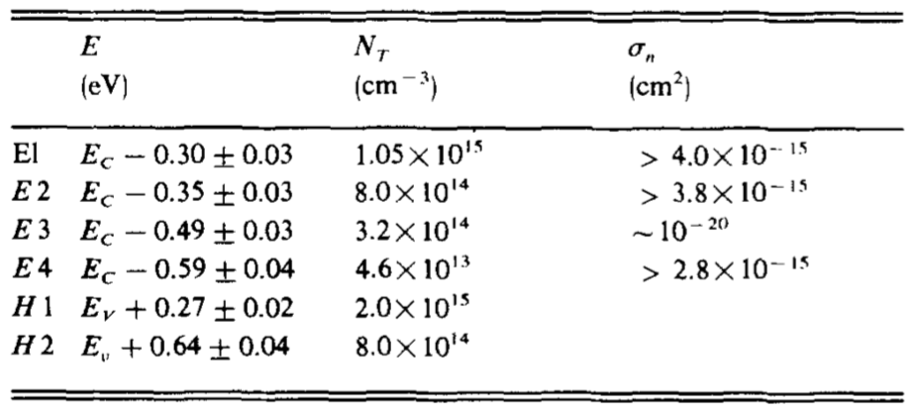
Measured parameters of the four electron traps and two hole traps in p⁺n junction diodes shown in Fig.2. The emission activation energy $E_{a}$ is corrected for the $T^{2}$ dependence of the prefactor. The trap density $N_{t}$ is obtained from the spatial profile, and $σ_{n}$ is the capture cross section for electrons.
Fig.2
Table I
TCAD
$$E_{ti}=−0.02±0.002(eV)$$
$$≈E_{t}−\left(E_{v}+E_{g}/2\right)$$
$$≈E_{t}−\left(E_{v}+0.67\right)$$
$$∴E_{t}≈E_{v}+0.65±0.002$$
The DLTS spectrum for a typical Zn-diffused p⁺n junction is shown in Fig.2 at a depth of 0.65μm for the junction. Four electrons traps and two hole traps were observed. Similar DLTS spectra were obtained from other samples prepared under different diffusion conditions with the exception of the deeper hole trap (H2) which was not always present. The measured activation energies $E_{a}$, maximum trap concentrations $N_{t}$, and capture cross-sections are summarized in Table I.
[17] S. R. McAfee, F. Capasso, D. V. Lang, A. Hutchinson, and W. A. Bonner, “A study of deep level in bulk n‐InP by transient spectroscopy,” Journal of Applied Physics, vol. 52, no. 10, pp. 6158–6164, Oct. 1981.

Slide 37
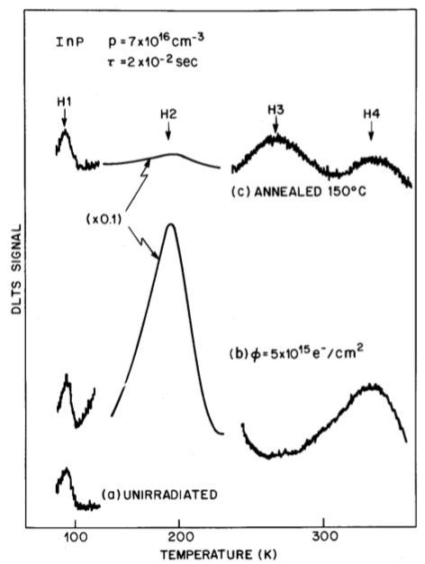
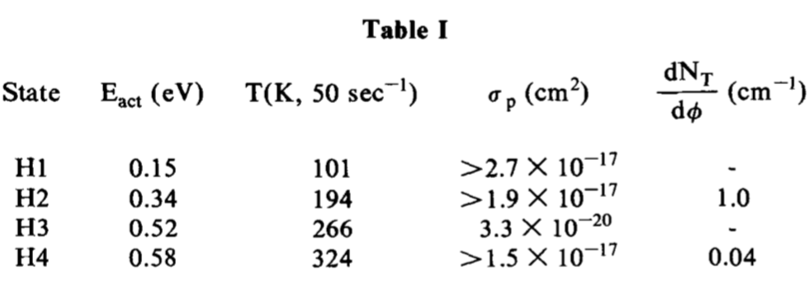
DLTS at a rate window of 50 sec⁻¹
A typical post-irradiation DLTS spectrum is shown in Fig. 1(b). Two peaks, H2 and H4, appear with introduction rates $dN_{t}/dφ$ of 1.0 and 0.04, and hole emission activation energies 0.34 and 0.58 eV respectively (Fig. 2). Again the hole capture rates were beyond experimental measurement capability yielding capture cross-sections greater than $1.9×{10}^{−17}$ and $1.5×{10}^{−17}$ cm², respectively. These parameters are summarized in Table I.
In summary, one defect state which is probably due to an impurity was observed in the unirradiated material. Irradiation resulted in two new defect states and a third appeared upon annealing at low temperature. The small introduction rates of all but the 0.34eV state suggest that mobilities are sufficient at room temperature to allow primary defects to diffuse out while the 0.34 eV state represents a lower mobility primary defect or stable complex.
$$E_{g}/2≈0.67(eV)$$
$$E_{H4}≈0.58(eV)$$
[18] M. Levinson, H. Temkin, and W. A. Bonner, “Electron bombardment induced defect states in p-InP,” Journal of Electronic Materials, vol. 12, no. 2, pp. 423–432, 1983.

Slide 38
Modeling after punch-through
Doping profile
Ionization coefficient model review
TCAD simulation results

Slide 39
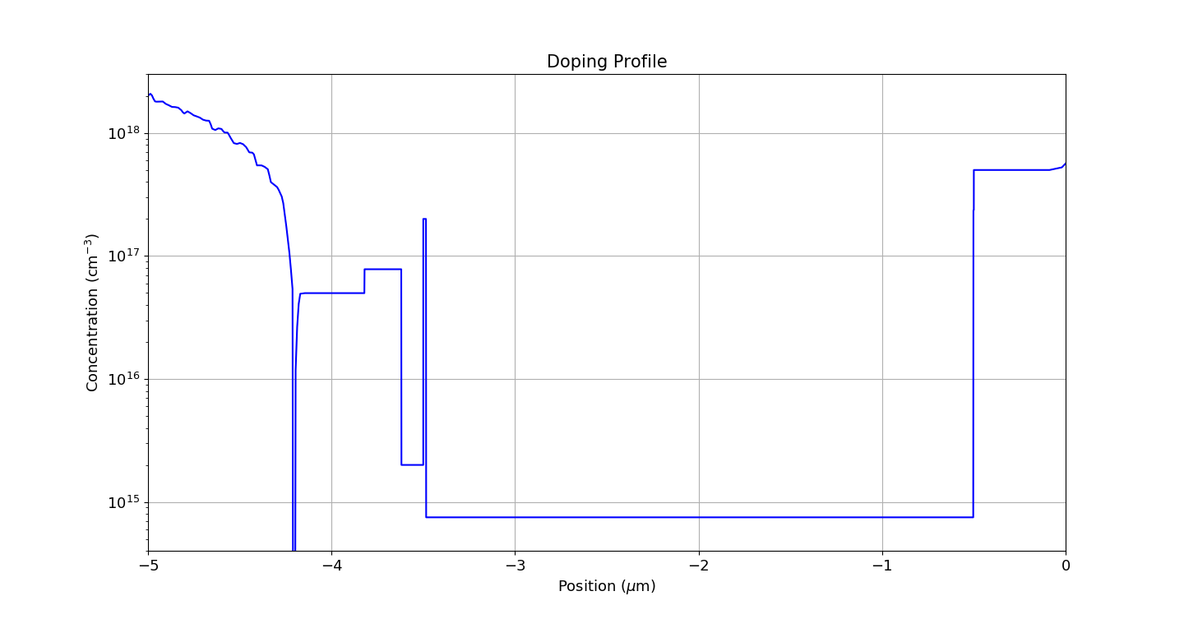
2e17
7.8e16
Multiplication layer: 0.42 μm
Charge layer: 0.2 μm
Grading layer: 0.12 μm
Thin charge layer in InGaAs: 15 nm
Absorption layer: 15 nm + 2.985 μm
5e16
2e15
7.5e14

Slide 40
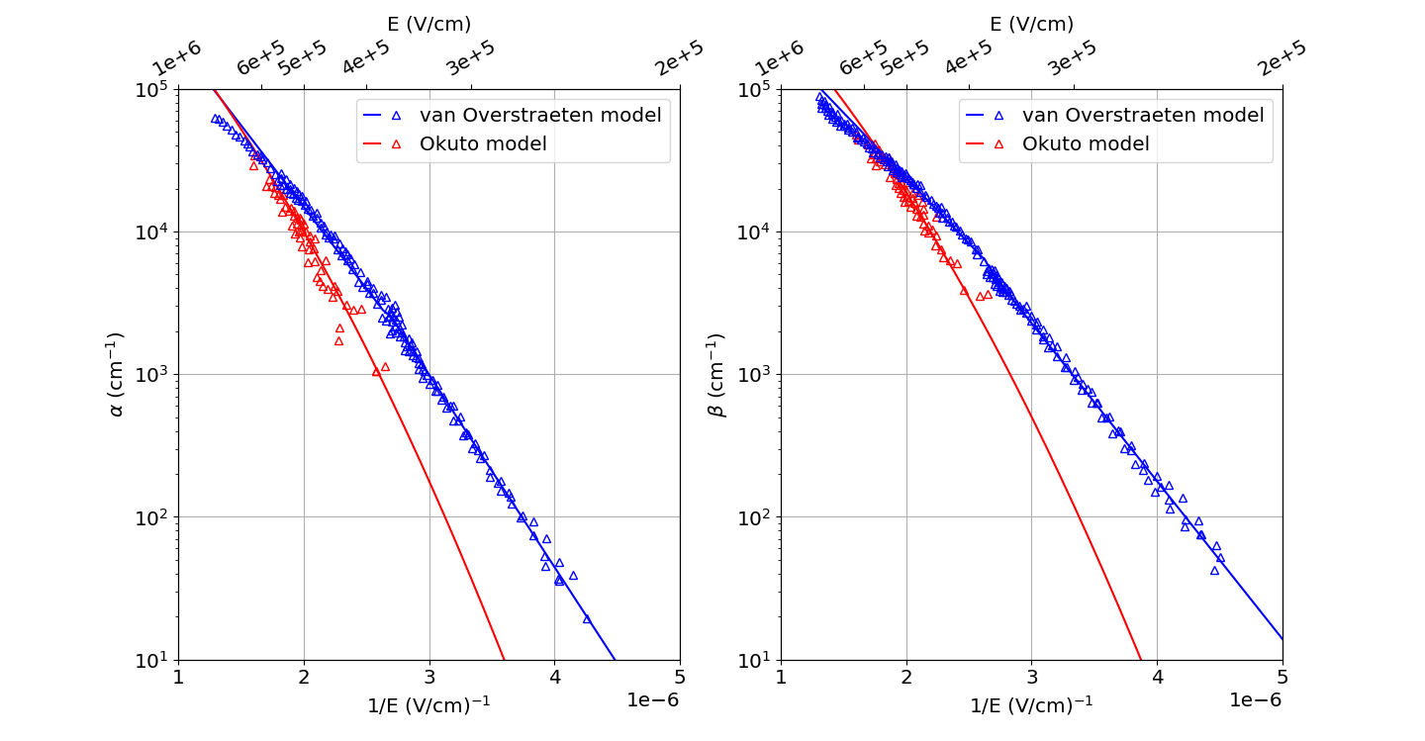

Slide 41
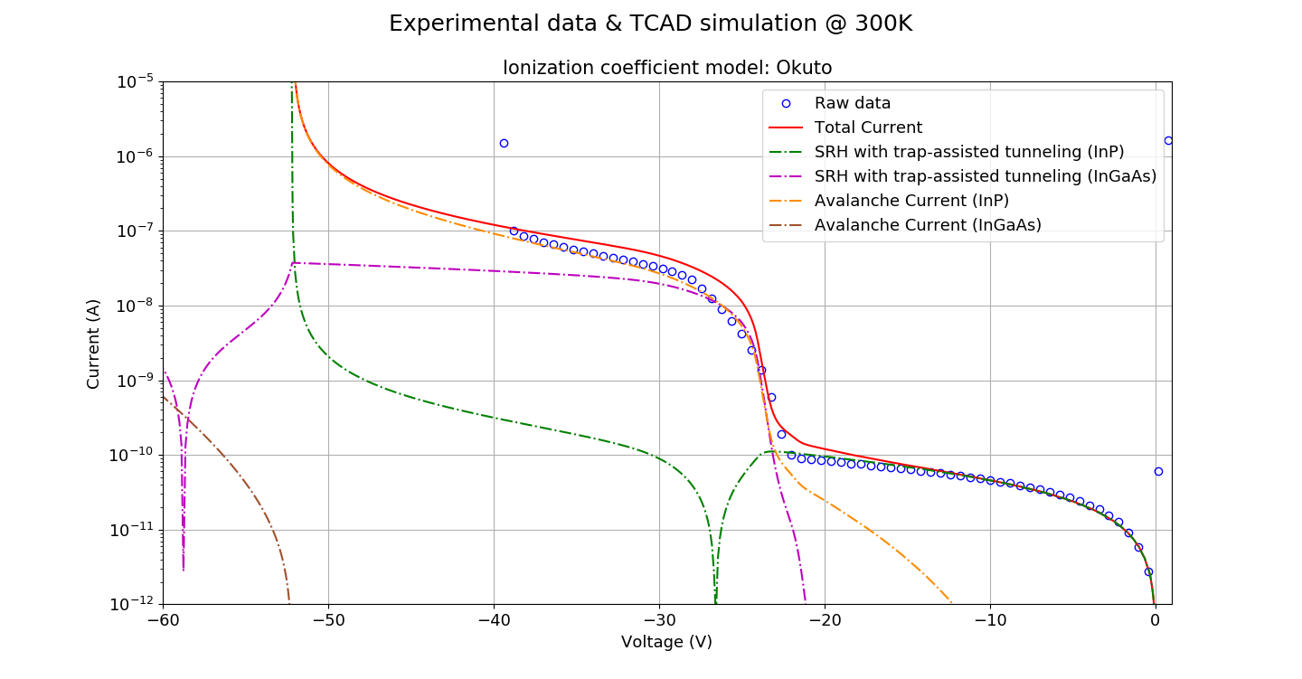
$$α\left(E\right)=A \text{exp}\left(−B/E\right),$$
$$E_{ti,InGaAs}=0.1(eV)$$
$$J_{avalanche}≡\int{\left(αnv_{n}+βpv_{p}\right)dx}$$
$$τ_{n0}=0.2\left(ns\right),$$
$$τ_{p0}=18 (ns)$$
InGaAs
$$m_{n}=0.0489,$$
$$m_{p}=0.45$$

Slide 42
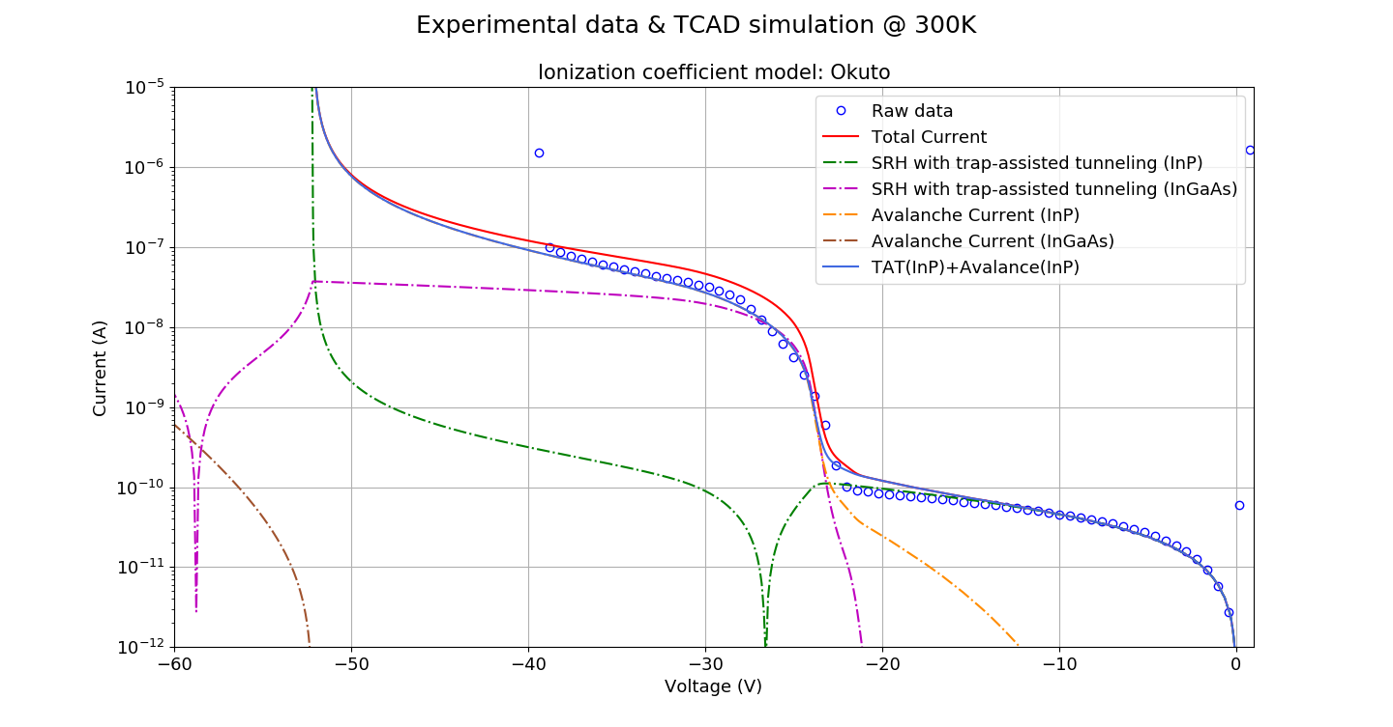
$$α\left(E\right)=A \text{exp}\left(−B/E\right),$$
$$E_{ti,InGaAs}=0.1(eV)$$
$$J_{avalanche}≡\int{\left(αnv_{n}+βpv_{p}\right)dx}$$
$$τ_{n0}=0.2\left(ns\right),$$
$$τ_{p0}=18 (ns)$$
InGaAs
$$m_{n}=0.0489,$$
$$m_{p}=0.45$$

Slide 43
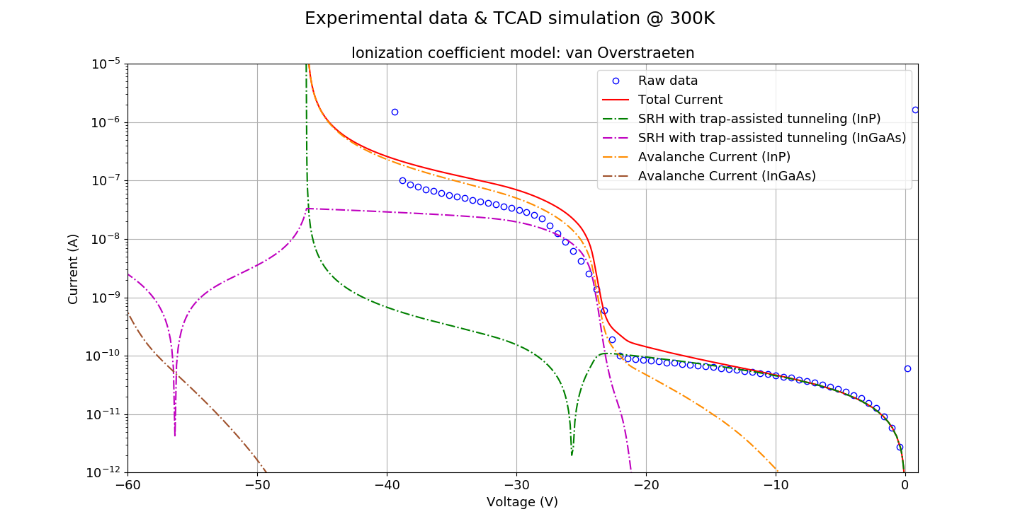
$$α\left(E\right)=A \text{exp}\left(−B/E\right),$$
$$E_{ti,InGaAs}=0.1(eV)$$
$$J_{avalanche}≡\int{\left(αnv_{n}+βpv_{p}\right)dx}$$
$$τ_{n0}=0.2\left(ns\right),$$
$$τ_{p0}=18 (ns)$$
InGaAs
$$m_{n}=0.0489,$$
$$m_{p}=0.45$$

Slide 44
[1] Liu, A., & Rosenwaks, Y. (1999). Excess carriers lifetime in InP single crystals: Radiative versus nonradiative recombination. Journal of applied physics, 86(1), 430-437.
[2] Yater, J. A., Weinberg, I., Jenkins, P. P., & Landis, G. A. (1994, December). Minority-carrier lifetime in InP as a function of light bias. In Proceedings of 1994 IEEE 1st World Conference on Photovoltaic Energy Conversion-WCPEC (A Joint Conference of PVSC, PVSEC and PSEC) (Vol. 2, pp. 1709-1712). IEEE.
. Picosecond time-resolved luminescence studies of surface and bulk recombination processes in InP. Physical Review B, 45(16), 9108. [3] Rosenwaks, Y., Shapira, Y., & Huppert, D. (1992)
[4] Landis, G. A., Jenkins, P., & Weinberg, I. (1991, April). Photoluminescence lifetime measurements in InP wafers. In [Proceedings 1991] Third International Conference Indium Phosphide and Related Materials (pp. 636-639). IEEE.
[5] Jenkins, P., Landis, G. A., Weinberg, I., & Kneisel, K. (1991, October). Minority carrier lifetime in indium phosphide. In The Conference Record of the Twenty-Second IEEE Photovoltaic Specialists Conference-1991 (pp. 177-181). IEEE.
[6] INSPEC (1991). Properties of indium phosphide (No. 6).
[7] Ahrenkiel, R. K., Dunlavy, D. J., & Hanak, T. (1988). Photoluminescence lifetime in heterojunctions. Solar Cells, 24(3-4), 339-352.
[8] Xu, J., Chen, X., Wang, W., & Lu, W. (2016). Extracting dark current components and characteristics parameters for InGaAs/InP avalanche photodiodes. Infrared Physics & Technology, 76, 468-473.
[9] Wang, X. D., Hu, W. D., Chen, X. S., Lu, W., Tang, H. J., Li, T., & Gong, H. M. (2008). Dark current simulation of InP/In 0.53 Ga 0.47 As/InP pin photodiode. Optical and quantum electronics, 40(14-15), 1261-1266.
[10] Parks, J. W., Smith, A. W., Brennan, K. F., & Tarof, L. E. (1996). Theoretical study of device sensitivity and gain saturation of separate absorption, grading, charge, and multiplication InP/InGaAs avalanche photodiodes. IEEE transactions on electron devices, 43(12), 2113-2121.
[11] M. Yamaguchi, S. Shinoyama, and C. Uemura, “Electron mobility and minority‐carrier lifetime of n‐InP single crystals grown by liquid‐encapsulated Czochralski method,” Journal of Applied Physics, vol. 52, no. 10, pp. 6429–6431, Oct. 1981.
[12] S. Bothra, S. Tyagi, S. K. Ghandhi, and J. M. Borrego, “Surface recombination velocity and lifetime in InP,” Solid State Electronics, vol. 34, no. 1, pp. 47–50, 1991.
[13] Y. Rosenwaks, Y. Shapira, and D. Huppert, “Evidence for low intrinsic surface-recombination velocity on p-type InP,” Phys. Rev. B, vol. 44, no. 23, pp. 97–100, Dec. 1991.
[14] Nolte, D. D. (1990). Surface recombination, free-carrier saturation, and dangling bonds in InP and GaAs. Solid-state electronics, 33(2), 295-298.
[15] A. B, K. MM, H. MI, D. OE, A. AA, A. F, and T. N, “Emerging frontiers of N-Type silicon material for photovoltaic applications: The impurity-defect interactions,” Front Nanosci Nanotech, vol. 1, no. 1, pp. 2–12, 2015.
[16] A. Mitonneau, A. Mircea, G. M. Martin, and D. Pons, “Electron and hole capture cross-sections at deep centers in gallium arsenide,” Rev. Phys. Appl. (Paris), vol. 14, no. 10, pp. 853–861, 1979.
[17] S. R. McAfee, F. Capasso, D. V. Lang, A. Hutchinson, and W. A. Bonner, “A study of deep level in bulk n‐InP by transient spectroscopy,” Journal of Applied Physics, vol. 52, no. 10, pp. 6158–6164, Oct. 1981.
[18] M. Levinson, H. Temkin, and W. A. Bonner, “Electron bombardment induced defect states in p-InP,” Journal of Electronic Materials, vol. 12, no. 2, pp. 423–432, 1983.

Slide 45
[1] Liu, A., & Rosenwaks, Y. (1999). Excess carriers lifetime in InP single crystals: Radiative versus nonradiative recombination. Journal of applied physics, 86(1), 430-437.
[2] Yater, J. A., Weinberg, I., Jenkins, P. P., & Landis, G. A. (1994, December). Minority-carrier lifetime in InP as a function of light bias. In Proceedings of 1994 IEEE 1st World Conference on Photovoltaic Energy Conversion-WCPEC (A Joint Conference of PVSC, PVSEC and PSEC) (Vol. 2, pp. 1709-1712). IEEE.
. Picosecond time-resolved luminescence studies of surface and bulk recombination processes in InP. Physical Review B, 45(16), 9108. [3] Rosenwaks, Y., Shapira, Y., & Huppert, D. (1992)
[4] Landis, G. A., Jenkins, P., & Weinberg, I. (1991, April). Photoluminescence lifetime measurements in InP wafers. In [Proceedings 1991] Third International Conference Indium Phosphide and Related Materials (pp. 636-639). IEEE.
[5] Jenkins, P., Landis, G. A., Weinberg, I., & Kneisel, K. (1991, October). Minority carrier lifetime in indium phosphide. In The Conference Record of the Twenty-Second IEEE Photovoltaic Specialists Conference-1991 (pp. 177-181). IEEE.
[6] INSPEC (1991). Properties of indium phosphide (No. 6).
[7] Ahrenkiel, R. K., Dunlavy, D. J., & Hanak, T. (1988). Photoluminescence lifetime in heterojunctions. Solar Cells, 24(3-4), 339-352.
[8] Xu, J., Chen, X., Wang, W., & Lu, W. (2016). Extracting dark current components and characteristics parameters for InGaAs/InP avalanche photodiodes. Infrared Physics & Technology, 76, 468-473.
[9] Wang, X. D., Hu, W. D., Chen, X. S., Lu, W., Tang, H. J., Li, T., & Gong, H. M. (2008). Dark current simulation of InP/In 0.53 Ga 0.47 As/InP pin photodiode. Optical and quantum electronics, 40(14-15), 1261-1266.
[10] Parks, J. W., Smith, A. W., Brennan, K. F., & Tarof, L. E. (1996). Theoretical study of device sensitivity and gain saturation of separate absorption, grading, charge, and multiplication InP/InGaAs avalanche photodiodes. IEEE transactions on electron devices, 43(12), 2113-2121.
[11] M. Yamaguchi, S. Shinoyama, and C. Uemura, “Electron mobility and minority‐carrier lifetime of n‐InP single crystals grown by liquid‐encapsulated Czochralski method,” Journal of Applied Physics, vol. 52, no. 10, pp. 6429–6431, Oct. 1981.
[12] S. Bothra, S. Tyagi, S. K. Ghandhi, and J. M. Borrego, “Surface recombination velocity and lifetime in InP,” Solid State Electronics, vol. 34, no. 1, pp. 47–50, 1991.
[13] Y. Rosenwaks, Y. Shapira, and D. Huppert, “Evidence for low intrinsic surface-recombination velocity on p-type InP,” Phys. Rev. B, vol. 44, no. 23, pp. 97–100, Dec. 1991.
[14] Nolte, D. D. (1990). Surface recombination, free-carrier saturation, and dangling bonds in InP and GaAs. Solid-state electronics, 33(2), 295-298.
[15] Hoffman, C. A., Jarašiūnas, K., Gerritsen, H. J., & Nurmikko, A. V. (1978). Measurement of surface recombination velocity in semiconductors by diffraction from picosecond transient free‐carrier gratings. Applied Physics Letters, 33(6), 536-539.
[16] H. C. Casey Jr. and E. Buehler, “Evidence for low surface recombination velocity on n‐type InP,” Appl. Phys. Lett., vol. 30, no. 5, pp. 247–249, Mar. 1977.
[17] A. B, K. MM, H. MI, D. OE, A. AA, A. F, and T. N, “Emerging frontiers of N-Type silicon material for photovoltaic applications: The impurity-defect interactions,” Front Nanosci Nanotech, vol. 1, no. 1, pp. 2–12, 2015.
[18] A. Mitonneau, A. Mircea, G. M. Martin, and D. Pons, “Electron and hole capture cross-sections at deep centers in gallium arsenide,” Rev. Phys. Appl. (Paris), vol. 14, no. 10, pp. 853–861, 1979.
[19] S. R. McAfee, F. Capasso, D. V. Lang, A. Hutchinson, and W. A. Bonner, “A study of deep level in bulk n‐InP by transient spectroscopy,” Journal of Applied Physics, vol. 52, no. 10, pp. 6158–6164, Oct. 1981.
[20] M. Levinson, H. Temkin, and W. A. Bonner, “Electron bombardment induced defect states in p-InP,” Journal of Electronic Materials, vol. 12, no. 2, pp. 423–432, 1983.

